Slide 1
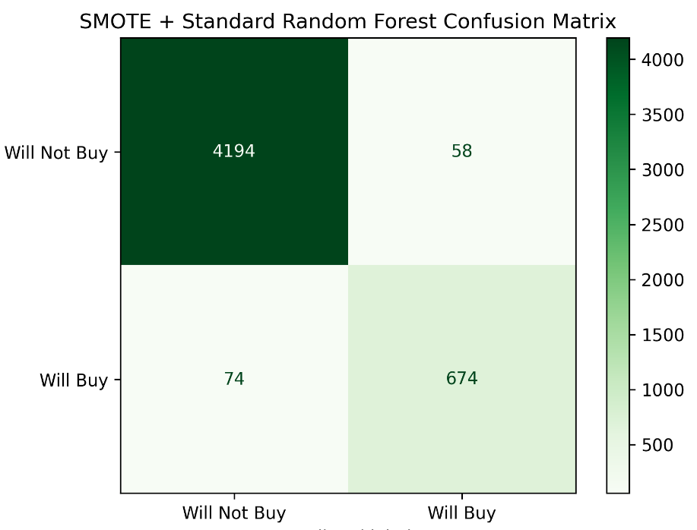
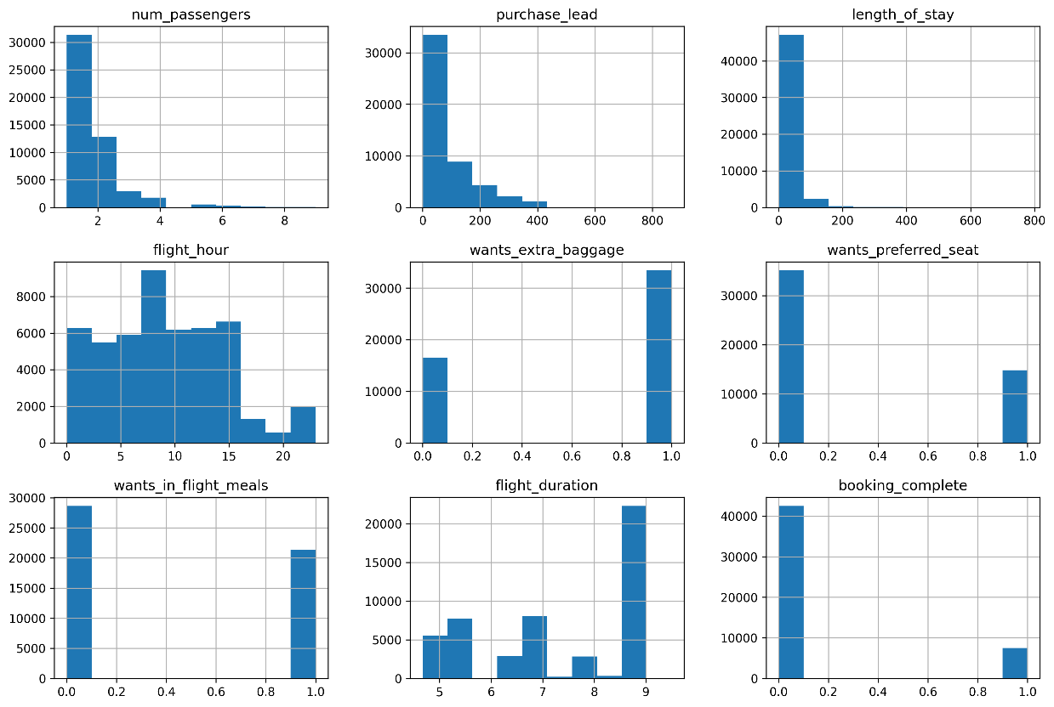
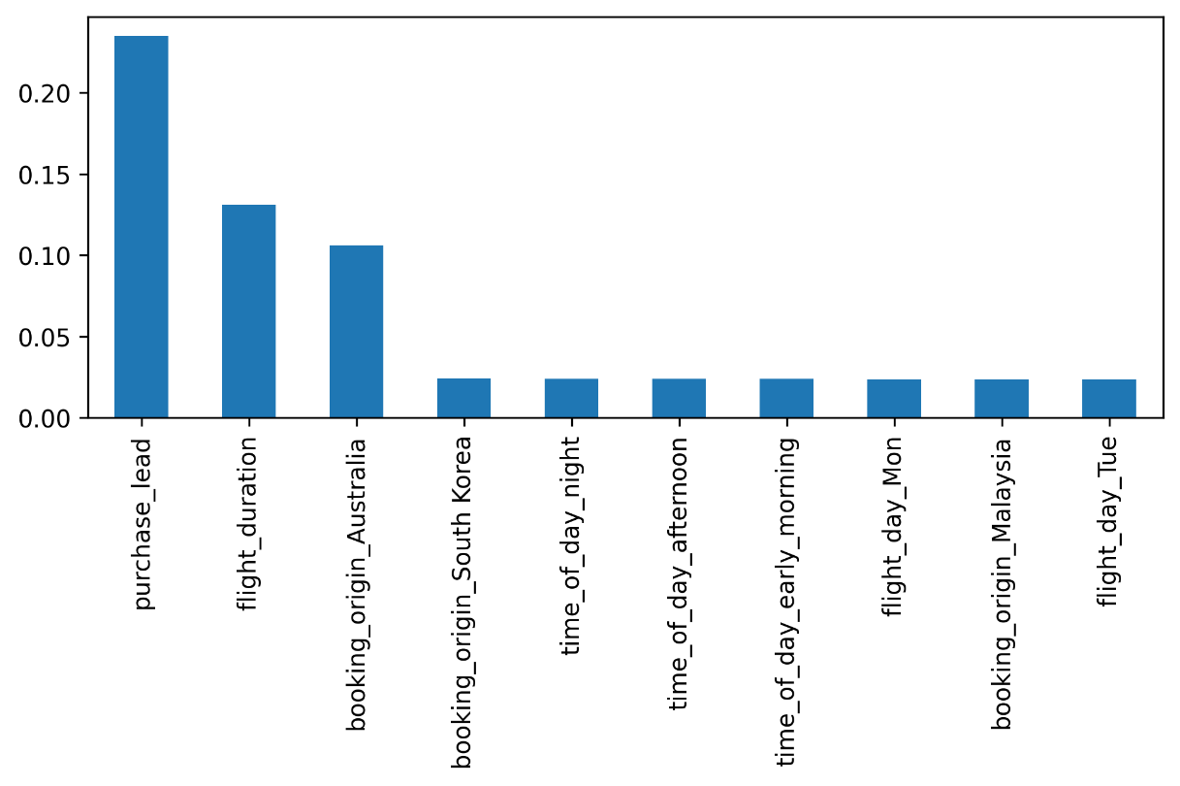
MODEL DETAILS
Average Evalution Metrics After Cross-validation:
Mean f1: 0.886
Mean recall: 0.879
Mean precision: 0.893
Model used: RandomForest from Scikit-Learn
Additional techniques: SMOTE (Synthetic Minority Oversampling Technique) to deal with class imbalance
Data manipulation/feature engineering: OneHotEncoding for features with non-numerical values
Classification Report:
precision recall f1-score support
0 0.98 0.99 0.98 4252
1 0.92 0.90 0.91 748
accuracy 0.97 5000
macro avg 0.95 0.94 0.95 5000
weighted avg 0.97 0.97 0.97 5000
After correcting for class imbalance before training the model with SMOTE, the model is quite accurate
Distribution of numerical data
Top 10 Variable Contributors
Mohammad Fakhir

